Slide 1
BUSINESS INTELLIGENCE
AND
DECISION MAKING
(#3)
Prof. Dr. Ercan Oztemel

Slide 2
CONTENTS…
Decision making process
Computer support for decision making
Decision support systems
Group DSS
Automated DSS
Business intelligence and DSS
Challanges and Future

Slide 3
QUESTIONS…
How are decisions made?
What methodologies can be applied?
What is the role of information systems in supporting decision making?
How can computers support decision making process
….
….

Slide 4

To make better decisions….
Decision makers need the right information in the
right moment in the right place !!!
This can effectively be assured by
Decision Support Systems (DSS) enriched by Business Intelligence (BI) techniques and tools employed together with domain knowledge and experience based judgement ( for autonomy- Intelligent Systems)

Slide 5
Well-defined and implemented decision making process is to be implemented.
Managers usually make decisions by following a four-step process (a.k.a. the scientific approach)
Define the problem (or opportunity)
Construct a model that describes the real-world problem
Identify possible solutions to the modeled problem and evaluate the solutions
Compare, choose, and recommend a potential solution to the problem

Slide 6
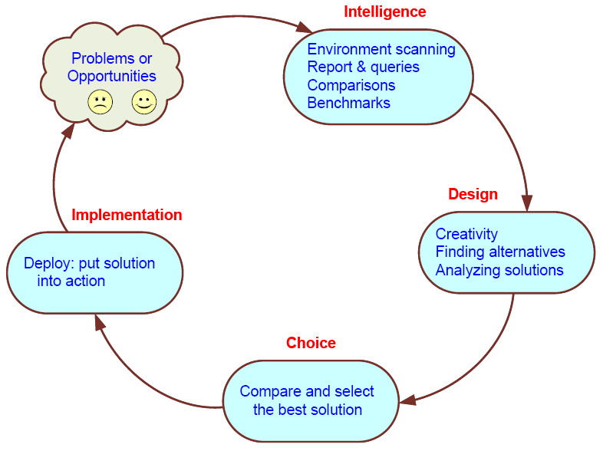
Simon’s Decision-Making Process

Slide 7
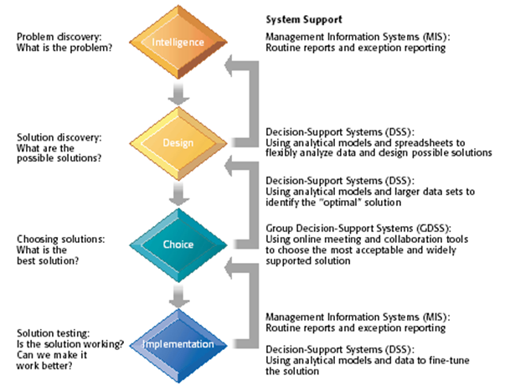
Simon’s Decision-Making Process

Slide 8
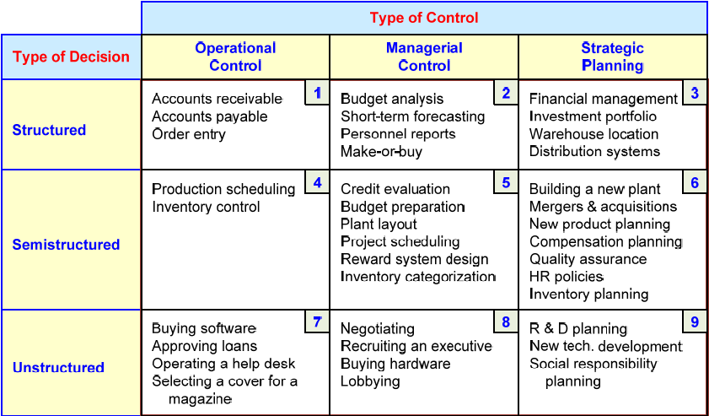
A decision support framework

Slide 9
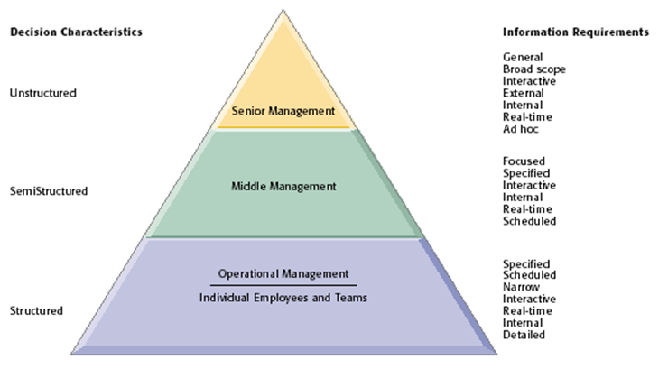
A decision support framework

Slide 10
Computer support for structured decisions
Structured problems: encountered repeatedly, have a high level of structure
It is possible to abstract, analyze, and classify them into specific categories
e.g., make-or-buy decisions, capital budgeting, resource allocation, distribution, procurement, and inventory control
For each category a solution approach is developed => Management Science

Slide 11
Computer support for semi-structured problems
Solving semi-structured problems may involve a combination of standard solution procedures and human judgment
MS handles the structured parts while DSS deals with the unstructured parts
With proper data and information, a range of alternative solutions, along with their potential impacts

Slide 12
Computer support for unstructured decisions
Unstructured problems can be only partially supported by standard computerized quantitative methods
They often require customized solutions
They benefit from data and information
Intuition and judgment may play a role
Computerized communication and collaboration technologies along with knowledge management is often used

Slide 13
Why use computerized support for decision making
Speedy computations: enables decision makers to perform quick computations, low cost, timely and thousands of alternatives can be evaluated fast
Improved communication and collaboration: groups in different locations can use the web-based tools to communicate
Increased productivity of group members: using web-based tools saves money and time, since group gathering in one place is no more needed. Also software help decision makers to determine the best way to run a business in a short time

Slide 14
Why use computerized support for decision making
Improved data management: data stored inside and outside the organization (web). Computers transmit, search and store needed data quickly, economically, securely and transparently (how?)
Managing giant data warehouses: computers can deal (store, access) with huge digital data of any type quickly (parallel computers)
Quality support: quality of decisions can be improved since more data can be accessed, more alternatives can be evaluated, view of experts can be collected quickly, AI methods can be used to derive expertise, and complex simulations can be performed.

Slide 15
Why use computerized support for decision making
Agility support: DS technologies (intelligent systems) can empower people by allowing them to make good decisions quickly, even if they lack knowledge.
Overcoming cognitive limits in processing and storing information: the man mind has limited ability to process and store information.

Slide 16
Decision Support Systems

Slide 17
Business Value of DSS
Providing fine-grained information for decisions that enable the firm to coordinate both internal and external business processes much more precisely
Helping with decisions in
Supply chain management
Customer relationship management
Pricing Decisions
Asset Utilization
Data Visualization: Presentation of data in graphical forms, to help users see patterns and relationships
Geographic Information Systems (GIS): Special category of DSS that display geographically referenced data in digitized maps

Slide 18
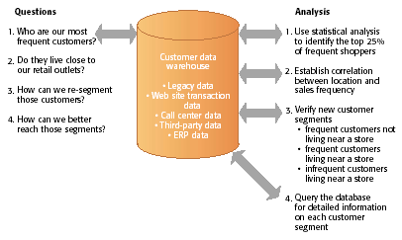
Example: A DSS for Customer Analysis and Segmentation

Slide 19
Web-Based Customer Decision-Support Systems
Customer decision making has become increasingly information intensive, with Internet search engines, intelligent agents, online catalogs, Web directories, e-mail, and other tools used to help make purchasing decisions.
DSS based on the Web and the Internet can support decision making by providing online access to various databases and information pools along with software for data analysis
Some of these DSS are targeted toward management, but many have been developed to attract customers.
Customer decision-support systems (CDSS) support the decision-making process of an existing or potential customer.

Slide 20
What Is a GDSS?
Group Decision-Support System (GDSS) is an interactive computer-based system used to facilitate the solution of unstructured problems by a set of decision makers working together as a group.

Slide 21
Overview of a GDSS Meeting
In a GDSS electronic meeting, each attendee has a workstation.
The workstations are networked and are connected to the facilitator’s console, which serves as the facilitator’s workstation and control panel, and to the meeting’s file server.
All data that the attendees forward from their workstations to the group are collected and saved on the file server.
The facilitator is able to project computer images onto the projection screen at the front of the room.
Many electronic meeting rooms have seating arrangements in semicircles and are tiered in legislative style to accommodate a large number of attendees.
The facilitator controls the use of tools during the meeting.

Slide 22
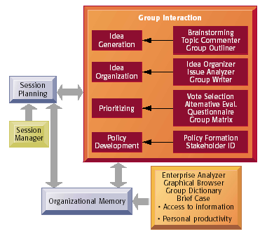
Group System Tools
Source: From Nunamaker et al., “Electronic Meeting Systems to Support Group Work,” Communication of the ACM, July 1991. Reprinted with permission.

Slide 23
Business Value of GDSS
Traditional decision-making meetings support an optimal size of three to five attendees. GDSS allows a greater number of attendees.
Enable collaborative atmosphere by guaranteeing contributor’s anonymity.
Enable non-attendees to locate organized information after the meeting.
Can increase the number of ideas generated and the quality of decisions while producing the desired results in fewer meetings
Can lead to more participative and democratic decision making

Slide 24
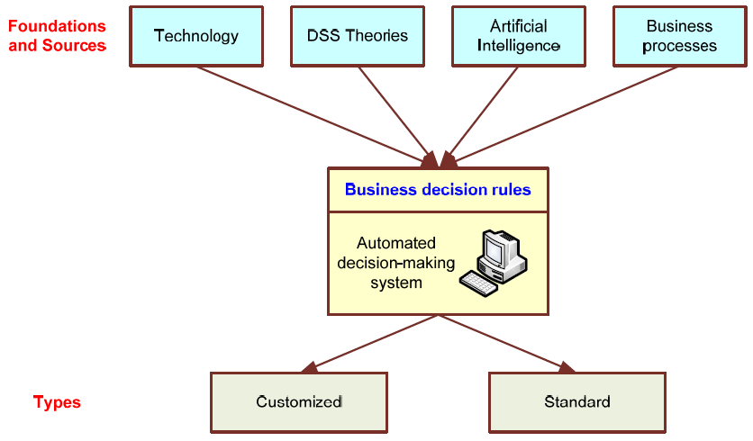
Automated Decision-Making Framework

Slide 25
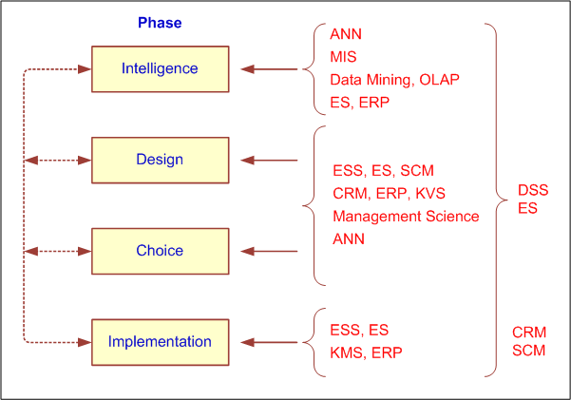
How Decisions Are Supported

Slide 27
Business intelligence and decision support
Business intelligence enables firms to:
Amass information
Develop knowledge about operations
Change decision-making behavior to achieve profitability and other business goals

Slide 28
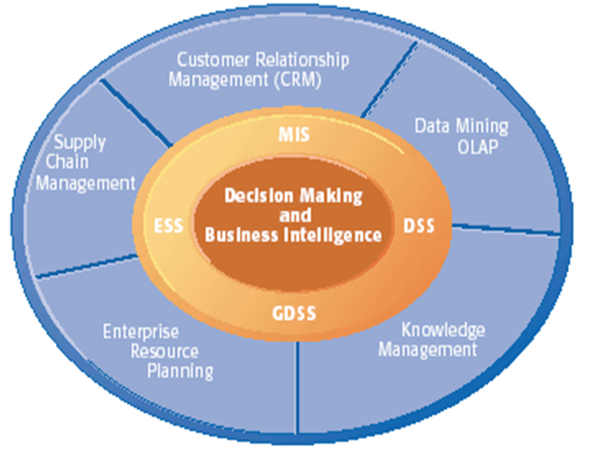
Systems and Technologies To facilitate Business Intelligence

Slide 29
Successful BI Implementation
Implementing and deploying a BI initiative is a lengthy, expensive, and risky endeavor!
Success of a BI system is measured by its widespread usage for better decision making
The typical BI user community includes
Not just the top executives (as was for EIS)
All levels of the management hierarchy
Provide what is needed to whom he/she needs it
A successful BI system can be of benefit to the enterprise as a whole…

Slide 30
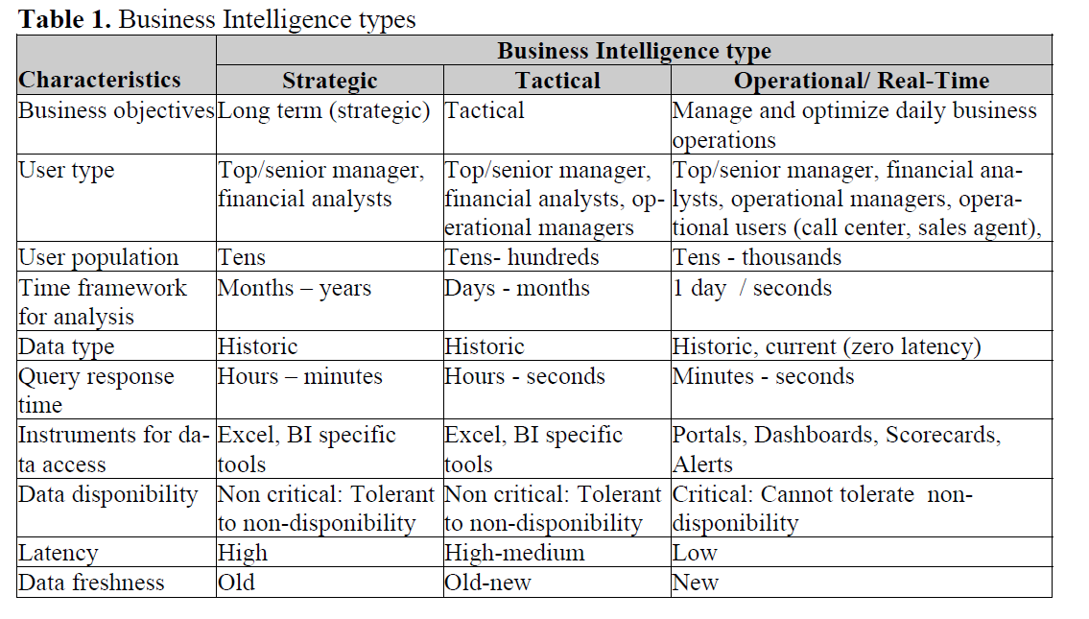

Slide 31
Successful BI Implementation…
BI combines products, technology, and methods to organize key information that management needs to improve decision making (profit, performance, ...)
BI is an enterprise-wide platform that supports reporting, analysis and decision making.
BI leads to:
Fact-based decision making
“Single version of the truth”

Slide 32
Fact-based decision making
Fact: something that has really occurred or is actually the case as opposed to what is merely inferred.
Decision: the final and definite result of examining a question, a conclusion, judgement….
Fact based decision: A judgement based on truths known by actual observation, as opposed to what is merely known

Slide 33
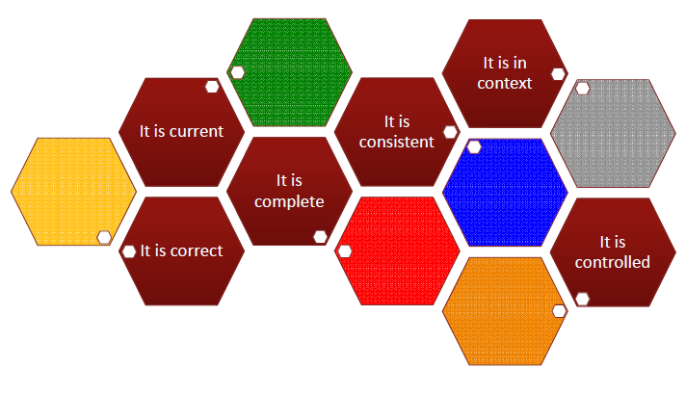
Data quality has to be well-maintained…

Slide 34
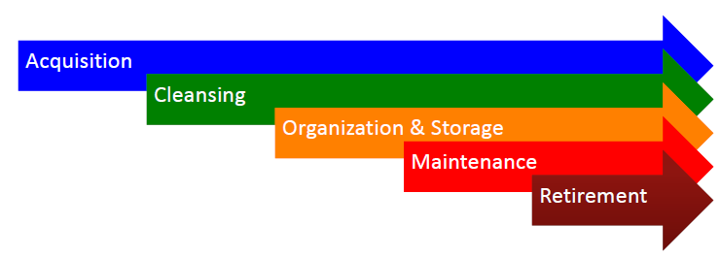
Well-structured data governance to be sustained effectively…
What rules and processes are needed to manage data from its creation through its retirement?

Slide 35
Quality, quality, quality….
Data quality is positively related to information quality
Information quality is positively related to the «quality of managerial decision making»
«BI management quality» is positively related to the quality of managerial decision making
The effect of «BI management quality» on the «quality of managerial decision making» is mediated by the scope of the BI solution

Slide 36
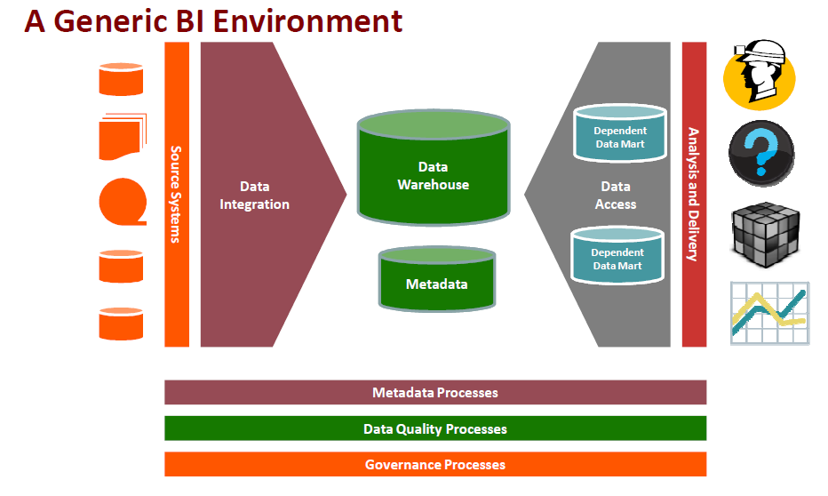
Required but not enough…

Slide 37
Real-Time, on-demand BI is necessary.
The demand for “real-time” BI is growing!
Technology is getting there…
Automated, faster data collection (RFID, sensors,… )
Database and other software technologies (agent, SOA, …) technology is advancing
Telecommunication infrastructure is improving
Computational power is increasing while the cost for these technologies is decreasing
Trent -> having more an more intelligent capabilities.

Slide 38
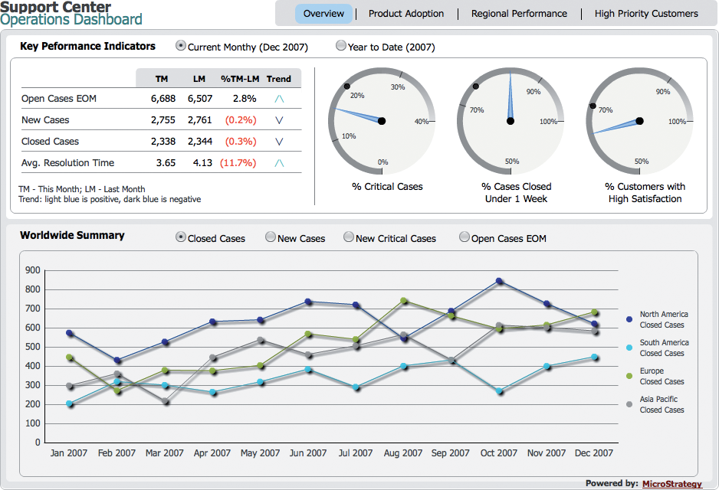
Presenting BI Results: Real-Time BI
Enables users to employ multi-dimensional analysis, data mining and decision support systems to analyze data in real time.

Slide 39
Changing business environment & computerized decision support
Companies are moving aggressively to computerized support of their operations ⇨ Business Intelligence
Business Pressures–Responses–Support Model
Business pressures result of today's competitive business climate
Responses to counter the pressures
Support to better facilitate the process

Slide 40
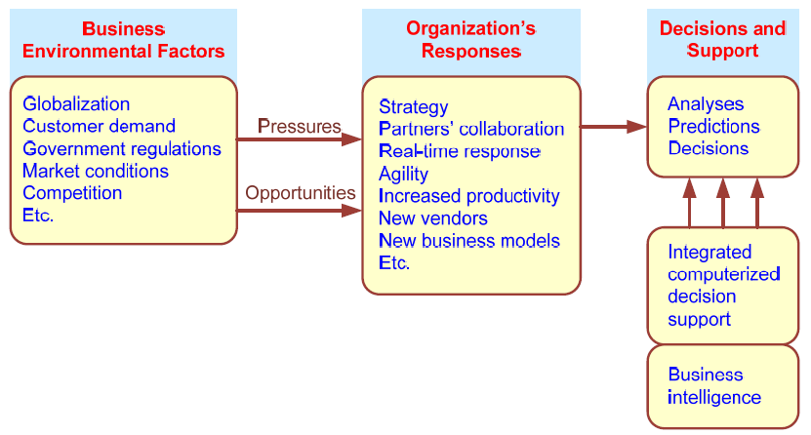
Business Pressures–Responses–Support Model

Slide 41
The Business Environment
The environment in which organizations operate today is becoming more and more complex, creating
opportunities, and
problems.
Example: globalization.
Business environment factors:
markets, consumer demands, technology, and societal…

Slide 42
Business Environment Factors
FACTOR DESCRIPTION
Markets Strong competition
Expanding global markets
Blooming electronic markets on the Internet
Innovative marketing methods
Opportunities for outsourcing with IT support
Need for real-time, on-demand transactions
Consumer Desire for customization
demand Desire for quality, diversity of products, and speed of delivery
Customers getting powerful and less loyal
Technology More innovations, new products, and new services
Increasing obsolescence rate
Increasing information overload
Social networking, Web 2.0 and beyond
Societal Growing government regulations and deregulation
Workforce more diversified, older, and composed of more women Prime concerns of homeland security and terrorist attacks
Necessity of Sarbanes-Oxley Act and other reporting-related legislation Increasing social responsibility of companies
Greater emphasis on sustainability

Slide 43
Organizational Responses
Be Reactive, Anticipative, Adaptive, and Proactive
Managers may take immediate actions, such as
Employing strategic planning.
Using new and innovative business models.
Restructuring business processes.
Participating in business alliances.
Improving corporate information systems.
… more [in the book]

Slide 44
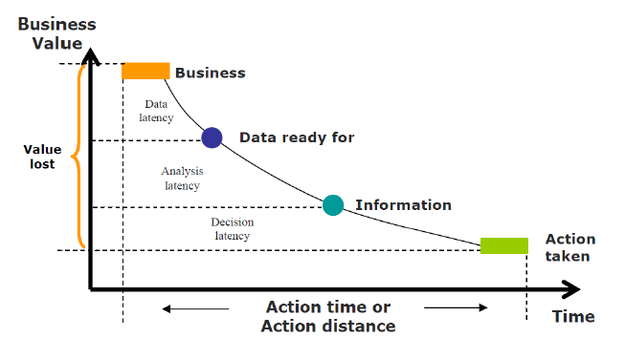
Time to take an action…

Slide 45
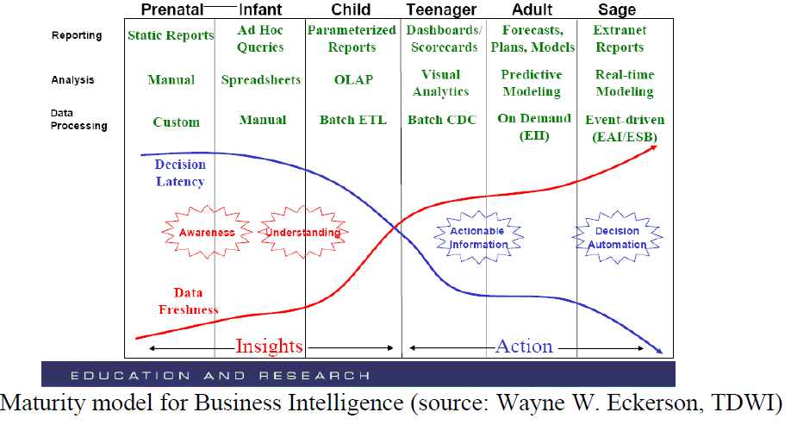
Maturity ….

Slide 46
Numerous Challenges…
The fundamental challenge is to display all the required information on a single screen, clearly and without distraction, in a manner that
can be assimilated quickly
Example: in designing the dashboard

Slide 47
Real Challege: Capability for analytic analysis
There is no douth on wether managers DO
analytics, the question is how well They DO it

Slide 48
Serious challenges…
By 2018, the United States alone could face a shortage of 140,000 to 190,000 people with deep analytical skills as well as 1.5 million managers and analysts with the know-how to use the analysis of big data to make effective decisions
!!!!!!

Slide 49
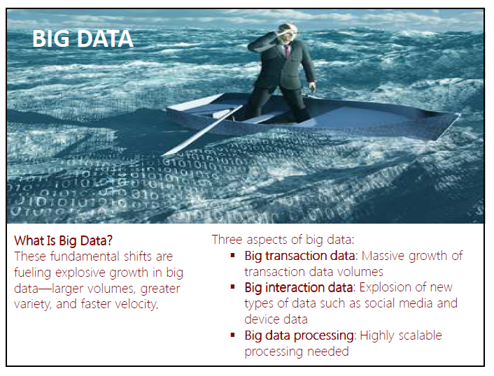
Need more support….

Slide 50
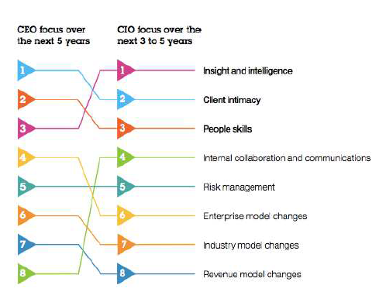
Need more intelligence….
Priorities …
CIOs and CEOs both aim to
focus on insight and
intelligence, client
intimacy and people skills
over the foreseeable future

Slide 51
FUTURE
Fully intelligent systems
Sensor based architectures (Software and hardware)
Unmanned decision making process
Machine communication language
Autonom structures
Machine collaborations in decision making
Machine negotiations and bargaining.
….

Slide 52
Intelligent systems
able to:
learn or understand from experience;
make sense out of ambiguous or contradictory messages;
respond quickly and successfully to a new situation;
use reasoning in solving problems and directing conduct effectively;
understand and infer in ordinary, rational ways;
apply knowledge to manipulate the environment;
think and reason; and
recognize the relative importance of different elements in a situation.

Slide 53
Intelligent Systems:Examples
Artificial Neural Networks (ANN)
Inductive Learning
Case-based Reasoning and Analogical Reasoning
Genetic Algorithms
Fuzzy Logic
Intelligent agents

Slide 54
Intelligent DSS
the required capabilities;
Incorporating specific domain knowledge
Learning and reasoning
Issuing recommendations
Drawing justifications.
Domain knowledge can be classified into two types:
factual knowledge consisting of explicit domain knowledge, such as facts, data, contexts, and relationships relevant to the decision problem.
expert knowledge consisting of implicit domain knowledge gained through years of experience.

Slide 55
Knowledge acquisition
To seek for the domain knowledge and elicit it from one or more expert and formalizing the knowledge acquired, using a suitable representational language, in a knowledge base;
This is the main bottleneck and is not an easy task.
A possible approach for domain-knowledge acquisition is to automatically induce specific domain knowledge directly from raw data
Potentially, large organizational databases contain useful information that can be used for decision making purposes, identifying strategically important information patterns.

Slide 56
Knowledge discovery
Knowledge discovery in databases (KDD) is the process of extracting useful patterns and models from raw data, and making those extracted patterns understandable and suitable for the resolution of decision problems.
KDD is a multistage process, in which data mining can be considered the core activity and it relates to the process and the set of techniques used to find (mine) underlying structure, information and relationships in normally large amounts of data.

